Slide 1

Blockchain
Prof. Sunitha R
Department of Computer Science and Engineering

Slide 2

Blockchain
Consensus Algorithms: PAXOS
Prof. Sunitha R
Department of Computer Science and Engineering

Slide 3
Blockchain
PAXOS
First Consensus Algorithm proposed by L. Lamport in 1989
Objective: choosing a single value under crash or network fault
System process
Making a proposal
Accepting a value
Handling Failures
Courtesy: Lamport, Leslie. "Paxos made simple." ACM Sigact News 32.4 (2001): 18-25.

Slide 4
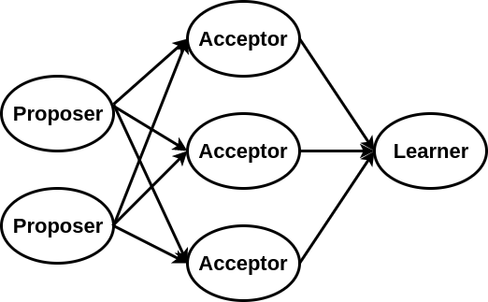
Blockchain
Components of PAXOS
Proposer: propose values that should be chosen by the consensus
Acceptor: form the consensus and accept values
Learner: learn which value was chosen by each acceptor
Courtesy: Lamport, Leslie. "Paxos made simple." ACM Sigact News 32.4 (2001): 18-25.

Slide 5
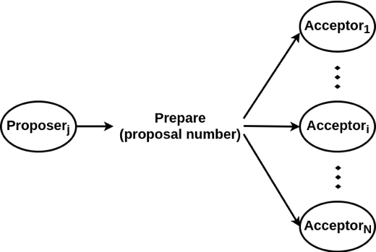
Blockchain
Consensus Algorithm – PAXOS
Making a Proposal: Proposer Process
proposal number: form a timeline, biggest number considered up-to-date

Slide 6
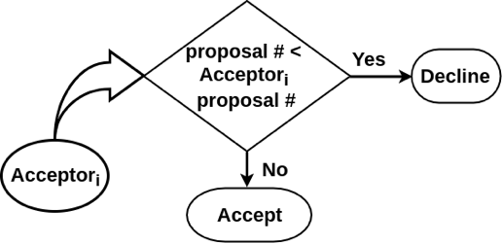
Blockchain
Consensus Algorithm – PAXOS
Making a Proposal: Acceptor’s Decision Making
Each acceptor compares received proposal number with the current known values for all proposer’s prepare message

Slide 7
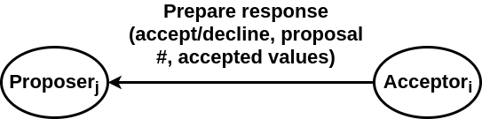
Blockchain
Consensus Algorithm – PAXOS
Making a Proposal: Acceptor’s Message
accept/decline: whether prepare accepted or not.
proposal number: biggest number the acceptor has seen.
accepted values: already accepted values from other proposer.

Slide 8
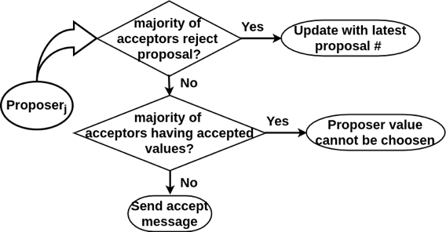
Blockchain
Consensus Algorithm – PAXOS
Accepting a Value: Proposer’s Decision Making
Proposer receive a response from majority of acceptors before proceeding

Slide 9
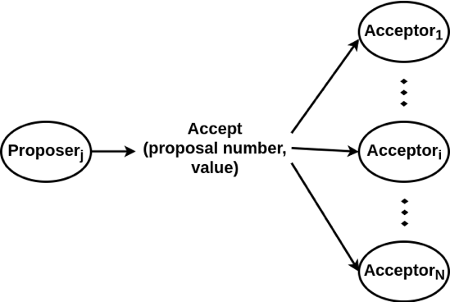
Blockchain
Consensus Algorithm – PAXOS
Accepting a Value: Accept Message
proposal number: same as prepare phase value
value: single value proposed by proposer

Slide 10
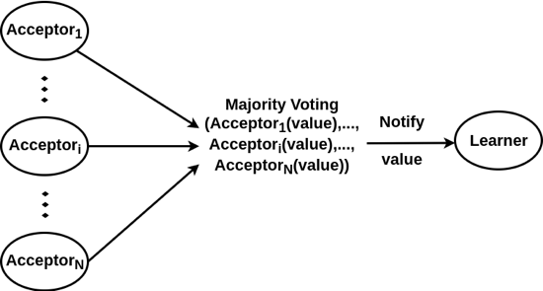
Blockchain
Consensus Algorithm – PAXOS
Accepting a Value: Notifying Learner
Each acceptor accept value from any of the proposer
Notify learner the majority voted value

Slide 11
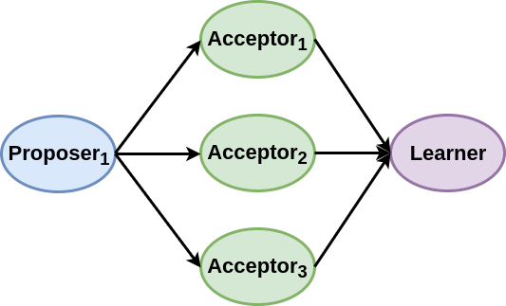
Blockchain
Consensus Algorithm – PAXOS
Single Proposer: No Rejection
Proposer always have proposal with biggest number
No proposal rejected

Slide 12
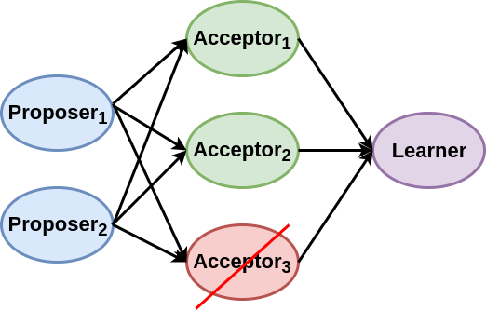
Blockchain
Consensus Algorithm – PAXOS
Handling Failure: Acceptor Failure
Acceptor fails during prepare
No issues, other acceptor can hear the proposal and vote

Slide 13
Blockchain
Consensus Algorithm – PAXOS
Handling Failure: Acceptor Failure
More than N/2 - 1 acceptors fail
no proposer get a reply
no values can be accepted

Slide 14
Blockchain
Consensus Algorithm – PAXOS
Handling Failure: Proposer Failure
Proposer fails during prepare phase
Acceptors wait, wait, wait, and then someone else become the proposer

Slide 15
Blockchain
Consensus Algorithm – PAXOS
Handling Failure: Proposer Failure
Proposer fails during accept phase
Acceptors have already agreed upon whether to choose or not to choose the proposal

Slide 16
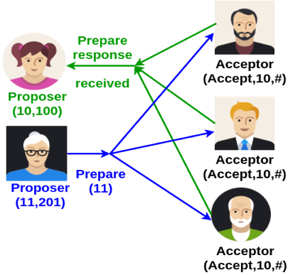
Blockchain
Consensus Algorithm – PAXOS
Handling Failure: Dueling Proposers
Proposer received confirmations to her prepare message from majority
– yet to send accept messages
Another proposer sends prepare message with higher proposal number
Block the first proposer’s proposal from being accepted

Slide 17
Blockchain
Consensus Algorithm – PAXOS
Handling Failure: Dueling Proposers
Use leader election - select one of the proposer as leader
Paxos can be used for leader election !!

Slide 18
Blockchain
Supplementary Study
Lamport, Leslie. "Paxos made simple." ACM Sigact News 32.4 (2001): 18-25.
A. Mocanu and C. Bădică, "Paxos-based weighted argumentation framework approach to distributed consensus," 2016 International Symposium on INnovations in Intelligent SysTems and Applications (INISTA), Sinaia, 2016, pp. 1-6.

Slide 19
THANK YOU
Sunitha R
Department of Computer Science and Engineering
sunithar@pes.edu

